Slide 1






ClimateWins Weather Predictions & Climate Change
Nancy Kolaski
September, 2024
?

Slide 2


Objective:
ClimateWins is a European nonprofit organization, that is interested in using machine learning to help predict the consequences of climate change around Europe and, potentially, the world.
Hypothesis:
ClimateWins can help predict climate change around Europe (and potentially, around the world).
The weather from ClimateWins locations are located at the top of a mountain and considered mostly ‘unpleasant’ conditions, and will therefore continue to be unpleasant in the future.
The weather climate across Europe will gradually increase over time.
Supervised Learning algorithms are are an optimal tool in in predictive analysis needed for weather forecasting.

Slide 3

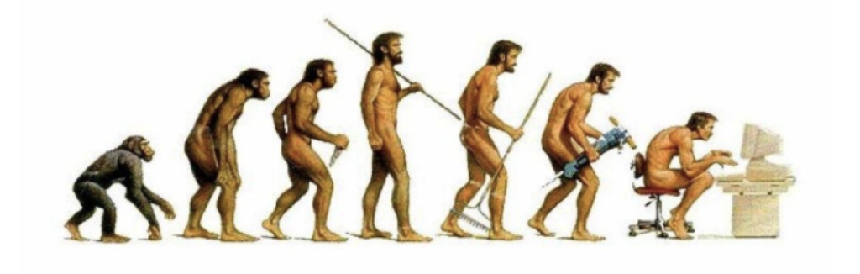
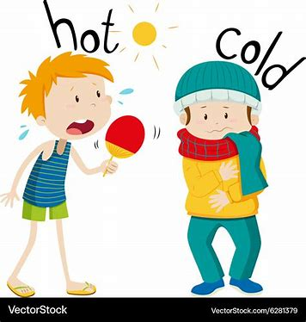

DATA: Data was collected between 1800s to 2022 by ‘European Climate Assessment and Data Set Project’ found at https://www.ecad.eu/
Bias
Location Bias:
data utilized for this analysis was primarily collected from extreme mountain top weather.
For this reason, this weather has been mostly categorized as ‘unpleasant’, or less than ideal for a picnic. This dataset is very unique in its location, and has little chance of generalizing to its intended location of Europe, and even less chance of generalizing to the rest of world
Temporal Bias:
data was collected across a vast time span (early 1800s to 2022).
The collection methods used prior to the technological advancements that exist now are prone to error and would not be as complete as the data collected in more recent years.
Regional or Cultural Bias:
Each region has had a history of exposure to certain climate events. They may have less readiness or action when compared to another. Interpretations may vary from region to region. What is considered hot weather would not tolerate cold and rainy temps. This skews any classification of pleasant vs. unpleasant, as we have in this dataset.
Small Sample Size:
Out of the 23,755 weather stations in Europe, this analysis only studied 18 weather stations.

Slide 4

What is optimization & what did it reveal about temperatures over the past 60 years?
Optimization lowers the risk of error and improves the accuracy of a model, often used to determine which algorithms to use. It helps understand valleys and peaks of the local/global landscape of the data.
Gradient Descent (used in both linear and nonlinear data) was used in this study to determine the local minimums and maximums of the data points.
Three iterations performed, adjusting step lengths (alpha) in order to get a result as near to 0 as possible
Follow on next slide

Slide 5
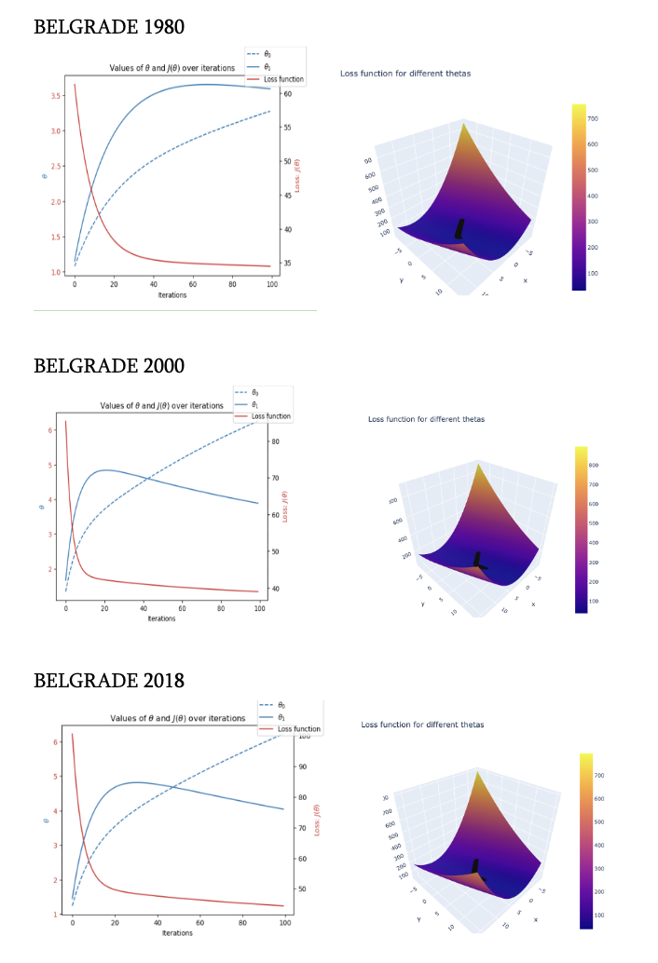
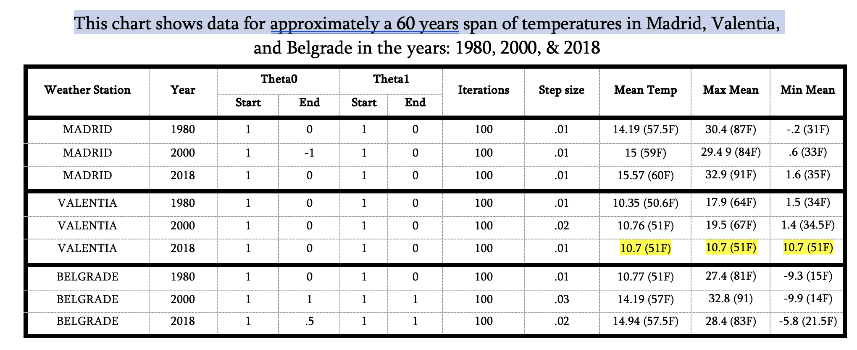
Is Climate Increasing?
Belgrade has freezing minimum temps getting colder over past 20 years. It has warmed up by about 5 degrees over past 60 years, when looking at the mean per year. The max mean raised 1 degree higher than 60 years ago).
In general, all means, mins, and max temperatures have increased, with the exception of Valencia (where data is likely skewed due to permanency of 10.7 report).
Belgrade:
3 iterations
showing
loss of function and loss profile

Slide 6
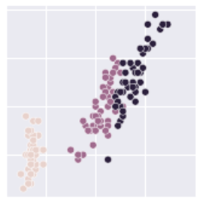

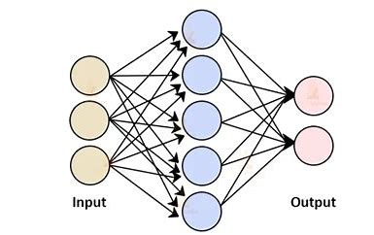
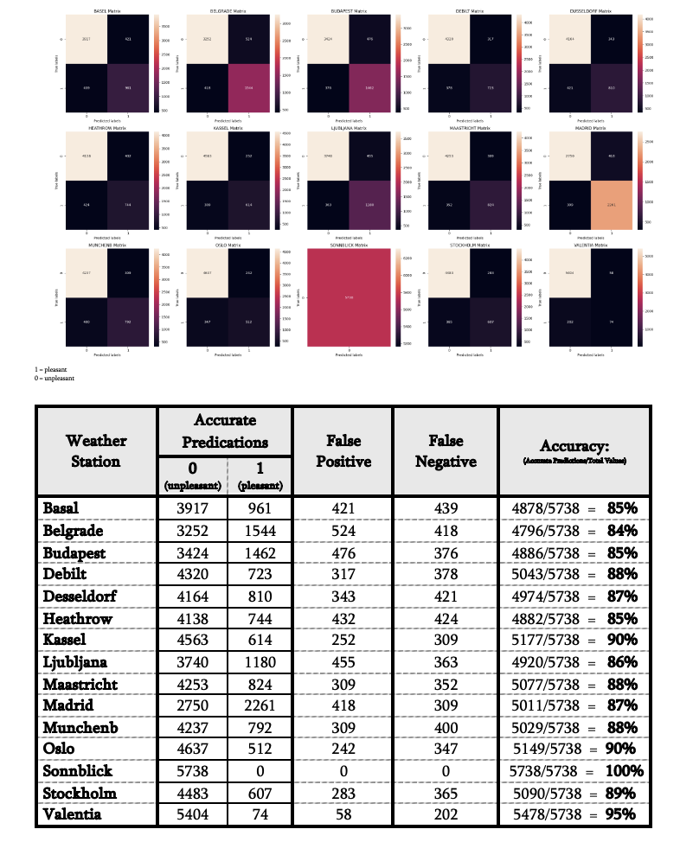
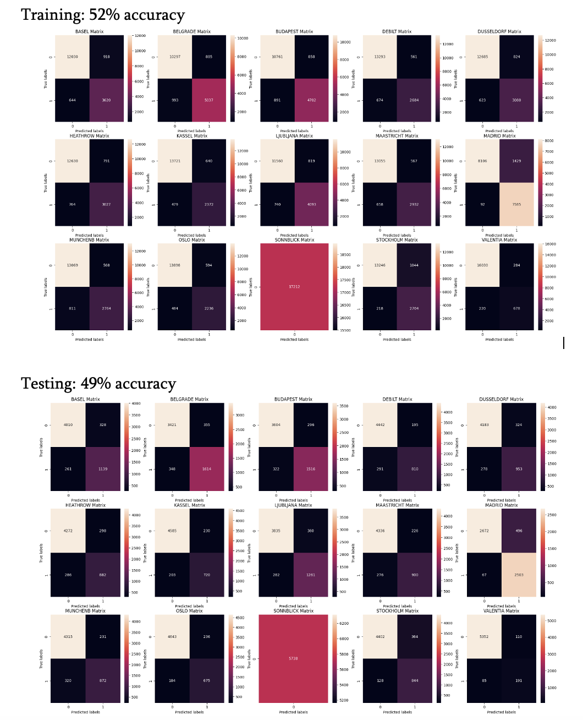
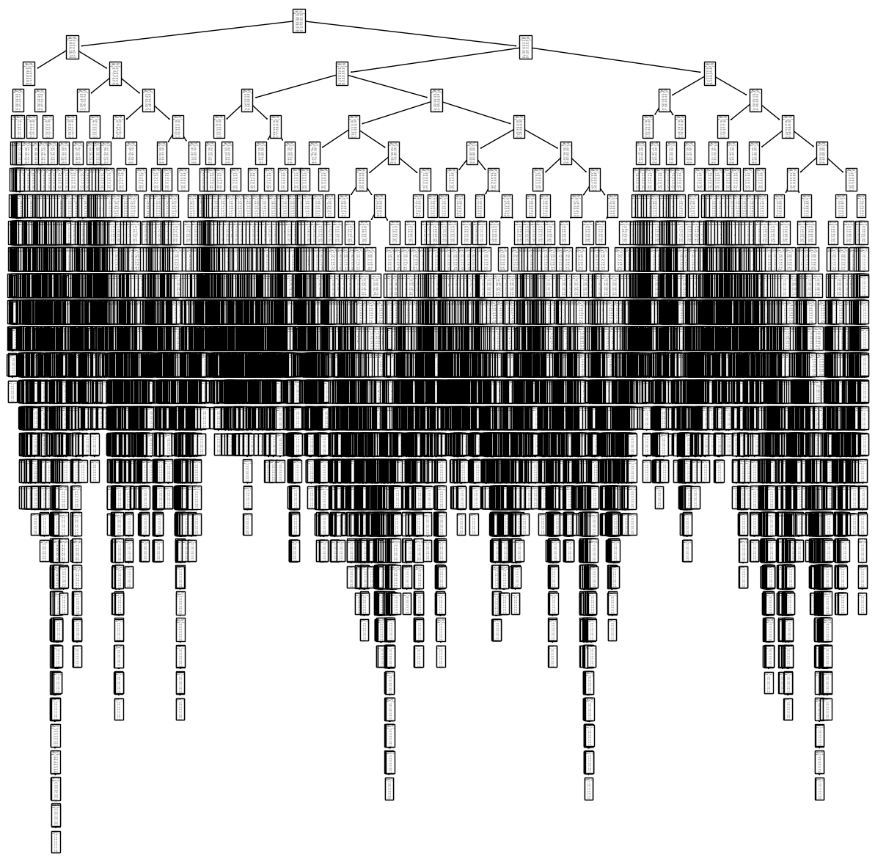
Supervised Machine Learning
K-Nearest Neighbor (KNN): classifies data on its proximity to its neighbors
Test Accuracy Scores = 88.46%
Artificial Neural Network(ANN):
Replicates the human brain, consisting of input and output layers, along with hidden layers by adjusting weights to obtain outcomes
Train accuracy score = 52%
Test Accuracy Score = 49%
Decision Tree
Decision trees model these kinds of questions for many objects at once. They have roots, branches, and leaves. The root is the first question asked, with yes/no answer. Leading to another question/ branch. The answer is the leaf/stopping point.
Train accuracy score = 46%,
Test Accuracy Score = 47%

Slide 7

Conclusion:
Supervised Machine Learning models can make accurate weather predictions
This study has already shown slight increase over time, and has potential to generalize to the rest of the world
KNN (K-Nearest Neighbor) model was the best choice for this study so far (88% accuracy, much higher when compared with the other two).
ANN (Artifical Neural Network) has potential to produce a more complete depiction of the data, presuming adjustments are made when eliciting this model as long as there is a good understanding of the model and how to manipulate it for best outcomes.
Decision Tree was not useful as the data was too deep and complex for a meaningful insight

Slide 8

Next Steps:
Prune Decision Tree data to reach a better conclusion and avoid overfitting
Run more iterations on ANN model to find more options for training the model to find more optimal variables.
Rule out of Sonnblick’s 100% accuracy was due to overfitting or data error
Make adjustments within the data
cleaning/checking for errors: as in the case of Valencia showing no variability in min/max/mean temps for the year chosen in this analysis
incorporating more complete data: include more descriptions of data when categorizing into ‘pleasant’ vs. ‘unpleasant’
Separate locations into hot/cold regions to eliminate cultural bias, particularly in perception of what is pleasant vs. unpleasant
Increase sample size and run the algorithms again to compare
more appropriate for generalizing to other locations and ultimately, the world

Slide 9

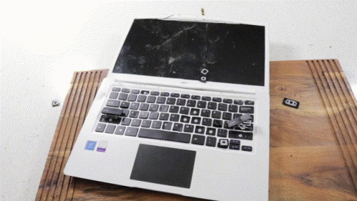
Thank you for your time and consideration.
Questions?
Nancy Kolaski
Nancykolaski@gmail.com
Github.com/Nancy-Kolaski

